Slide 1
ReFood Share
Done by : Murshid TP
Reg No:VDA20MCA-2041
Roll No:44
Guide:Dr Bindu S Mony

Slide 2
Abstract
Wasting food is a common problem in our society. Food waste management is crucial since it can improve our environmental and economic sustainability.
This web application is used to manage wastage foods in a useful way.
We have identified the use of technology to reduce food waste management and built an web application that allows marriages, canteens, restaurants, social and family get-togethers and functions to donate and share their foods and leftovers with people in need.
In general we are automating the process of the food wastages.

Slide 3
Introduction
Wasting food is a common problem in our society. Food waste management is crucial since it can improve our environmental and economic sustainability.
This web application is used to manage wastage foods in a useful way.
We have identified the use of technology to reduce food waste management and built an web application that allows marriages, canteens, restaurants, social and family get-togethers and functions to donate and share their foods and leftovers with people in need.
In general we are automating the process of the food wastages.

Slide 4
Existing System
In existing system if anyone have extra food because of any function in their home,remaining food in hotels,canteens it will be become waste because instantly there is no way to share with anyone if they are having lots of food .
Even if they want to give that extra food to any orphanage or poor people they don’t have time or don’t have an idea about that.

Slide 5
Proposed System
In proposed system we are reduce that food wastage using this application.
This project is food redistribution is an enormously successful social innovation that tackles food waste and food poverty.
In this system the user’s request for food to donor,after requesting the food,the donor get an alert message and this time donor can donate the food.
Through this way we can reduce food wastage problem.

Slide 6
Modules
Admin
Donor
User

Slide 7
1.Admin
Secure admin login system.
Dashboard: In this section, admin can view total state, total city, Total Food. Donor, Total Listed Food, All Food Request, New Food Request and Rejected Food Request.
State: In this section, admin can manage state (Add/Update/Del).
City: In this section, admin can manage city (Add/Update/Del).
Reg Food Donor: In this section, admin can view registered food donor.
Listed Food: In this section, admin can view the listed food by food donor.
Food Request: In this section, admin can view the request for food.
Pages: In this section, admin can manage about us and contact us pages.

Slide 8
2.Donor
Signup: In this section, Donor can register yourself.
Sign in: After successful registration Donor can login with valid credentials.
Dashboard: In this section, donor can view total listed food and total food take away.
Donate Food: In this section, donor can list the donated food detail.
Request: In this section, donor can view the request which is send by user.

Slide 9
3.User
Home: User can visit the website and check the details.
About Us: User can see the details of the website.
Contact Us: User can see the contact detail and contact the website administrator.
Food Available List: User can view available donated food and send the request for food.
Request Food: User can also request for available food.

Slide 10
Software & Hardware requirements
Software requirements
Front End: HTML, CSS, JAVA
SCRIPT
Back End: PHP
Database: MySQL
Hardware requirements
Processor speed: 1.0 GHz
RAM : 2GB
Hard disk: 3 GB free disk space

Slide 11
ScreenShots

Slide 12
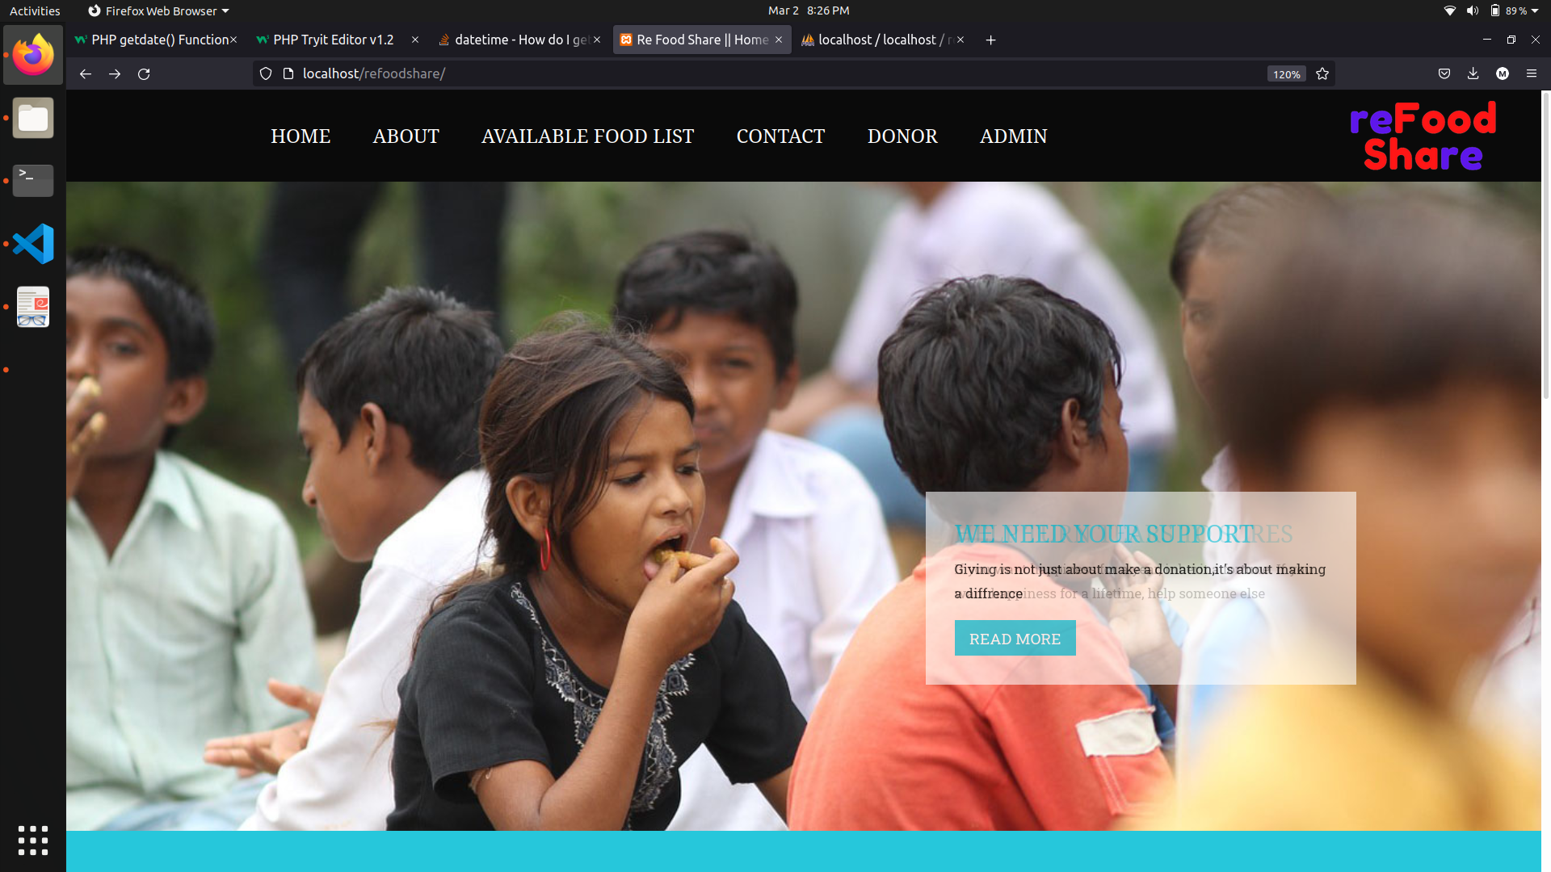

Slide 13
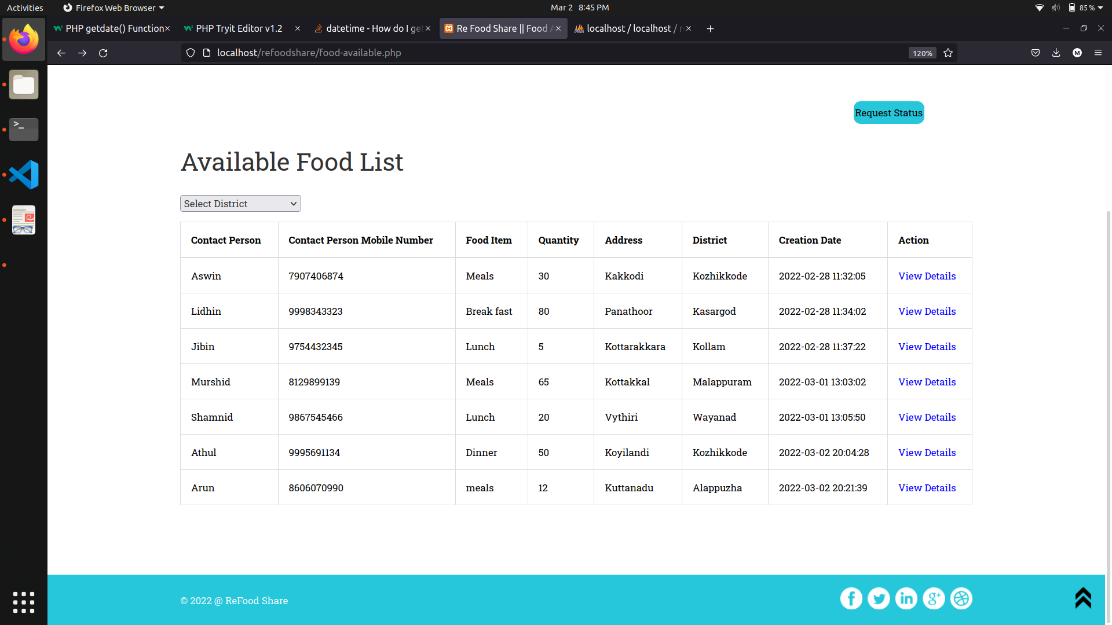

Slide 14
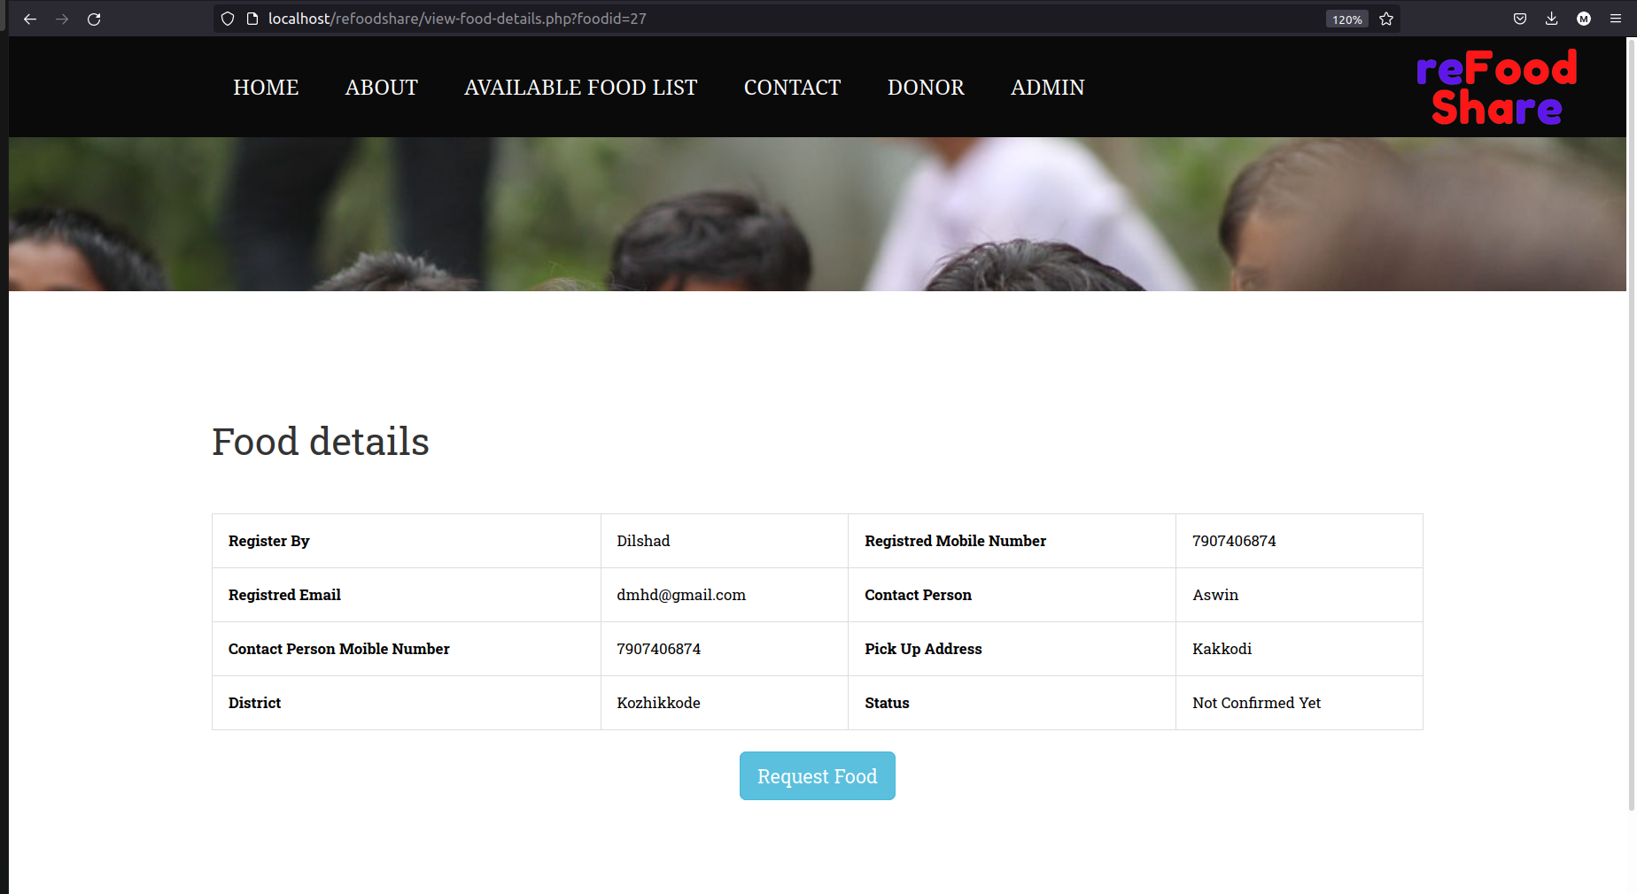

Slide 15
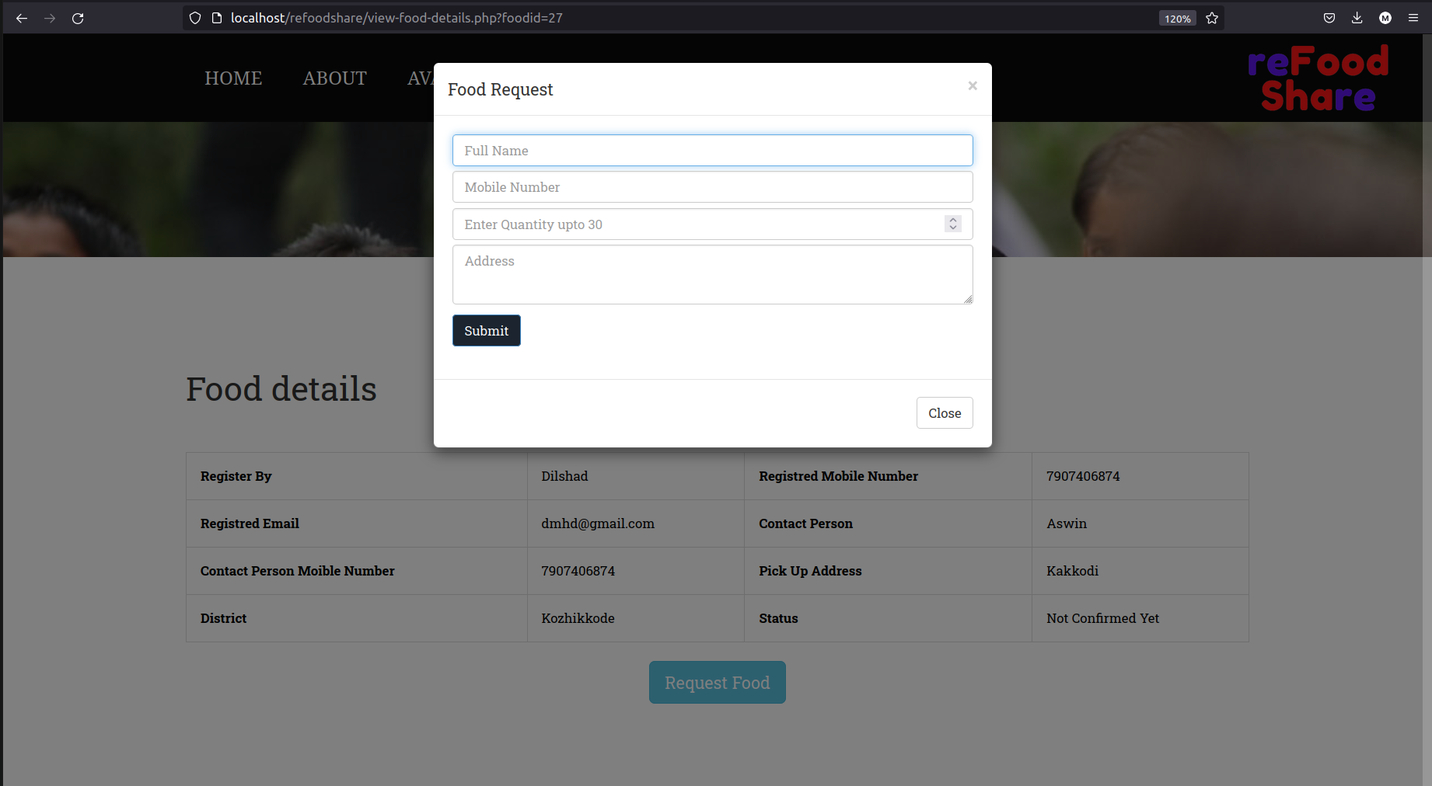

Slide 16
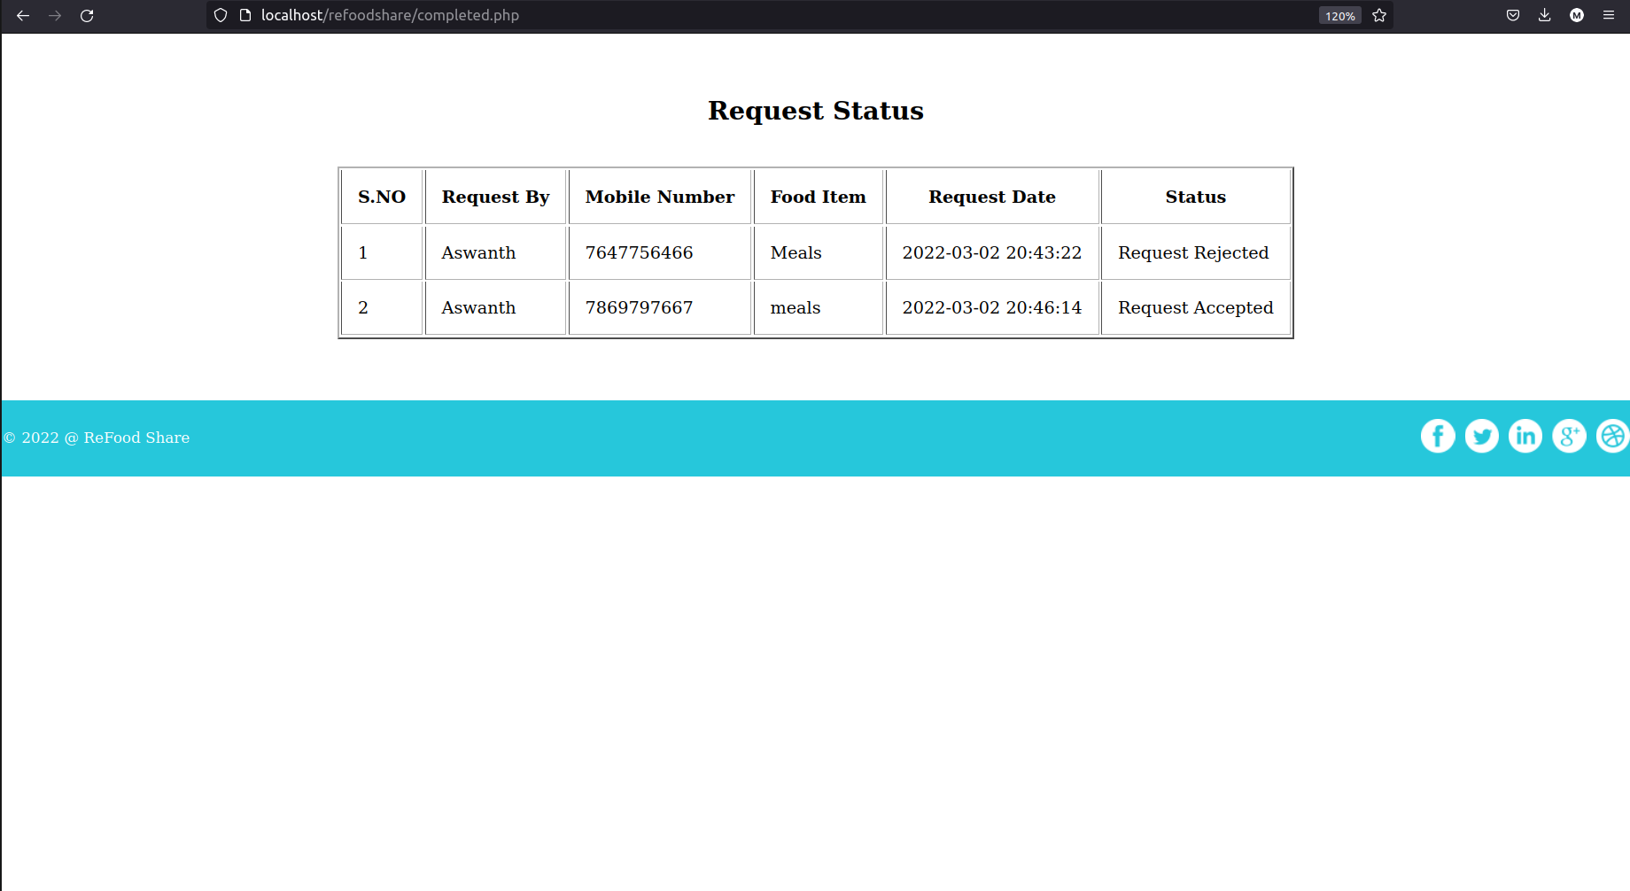

Slide 17
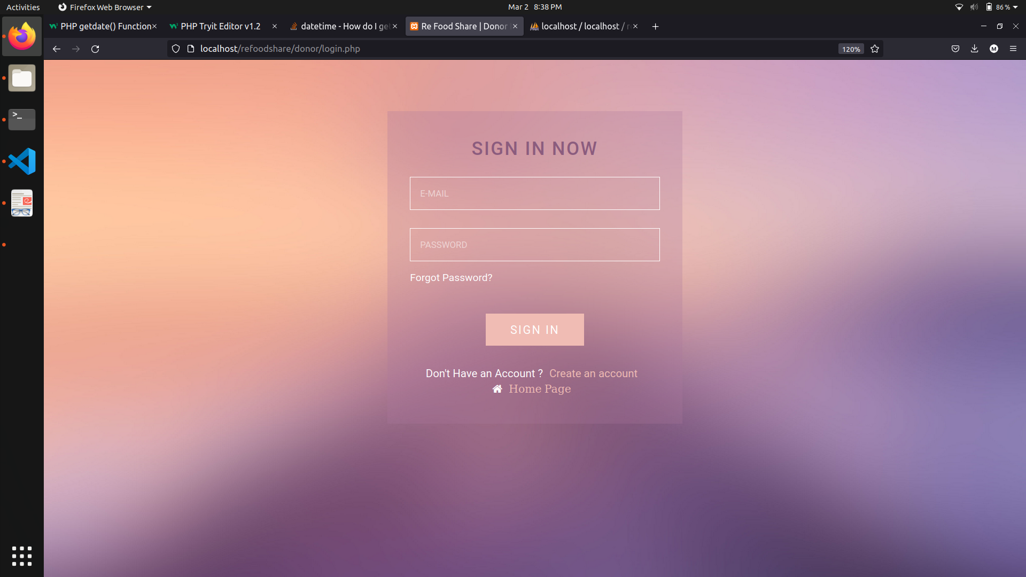

Slide 18
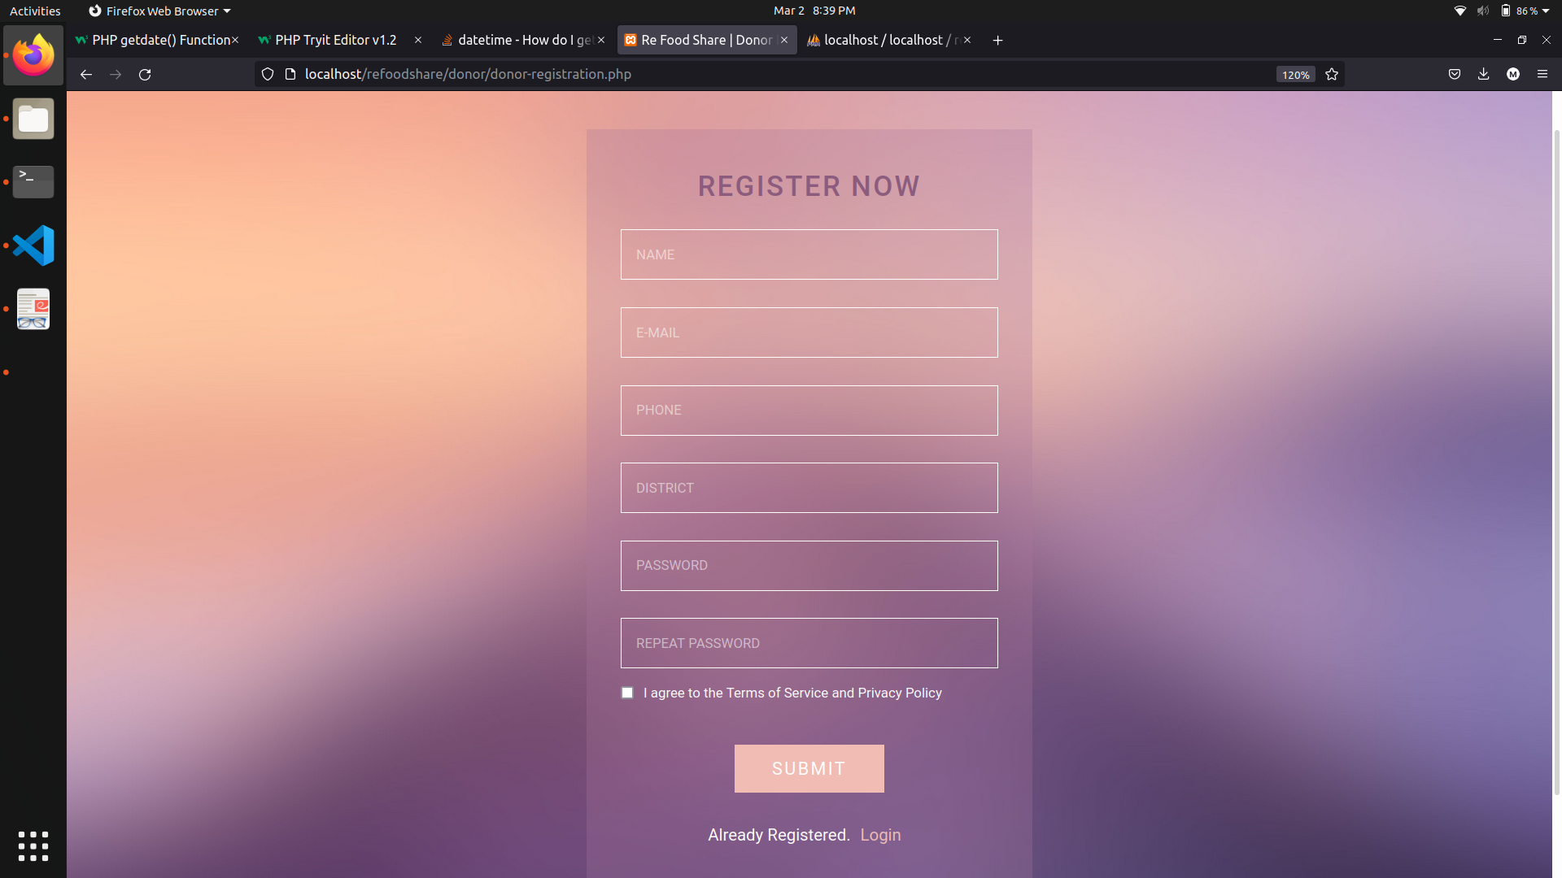

Slide 19
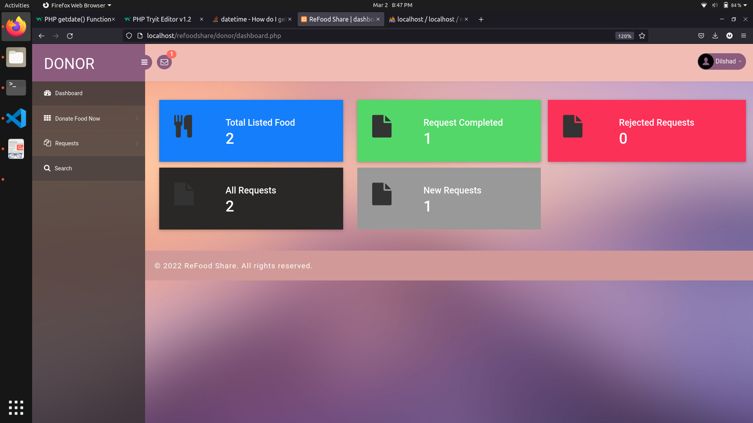

Slide 20
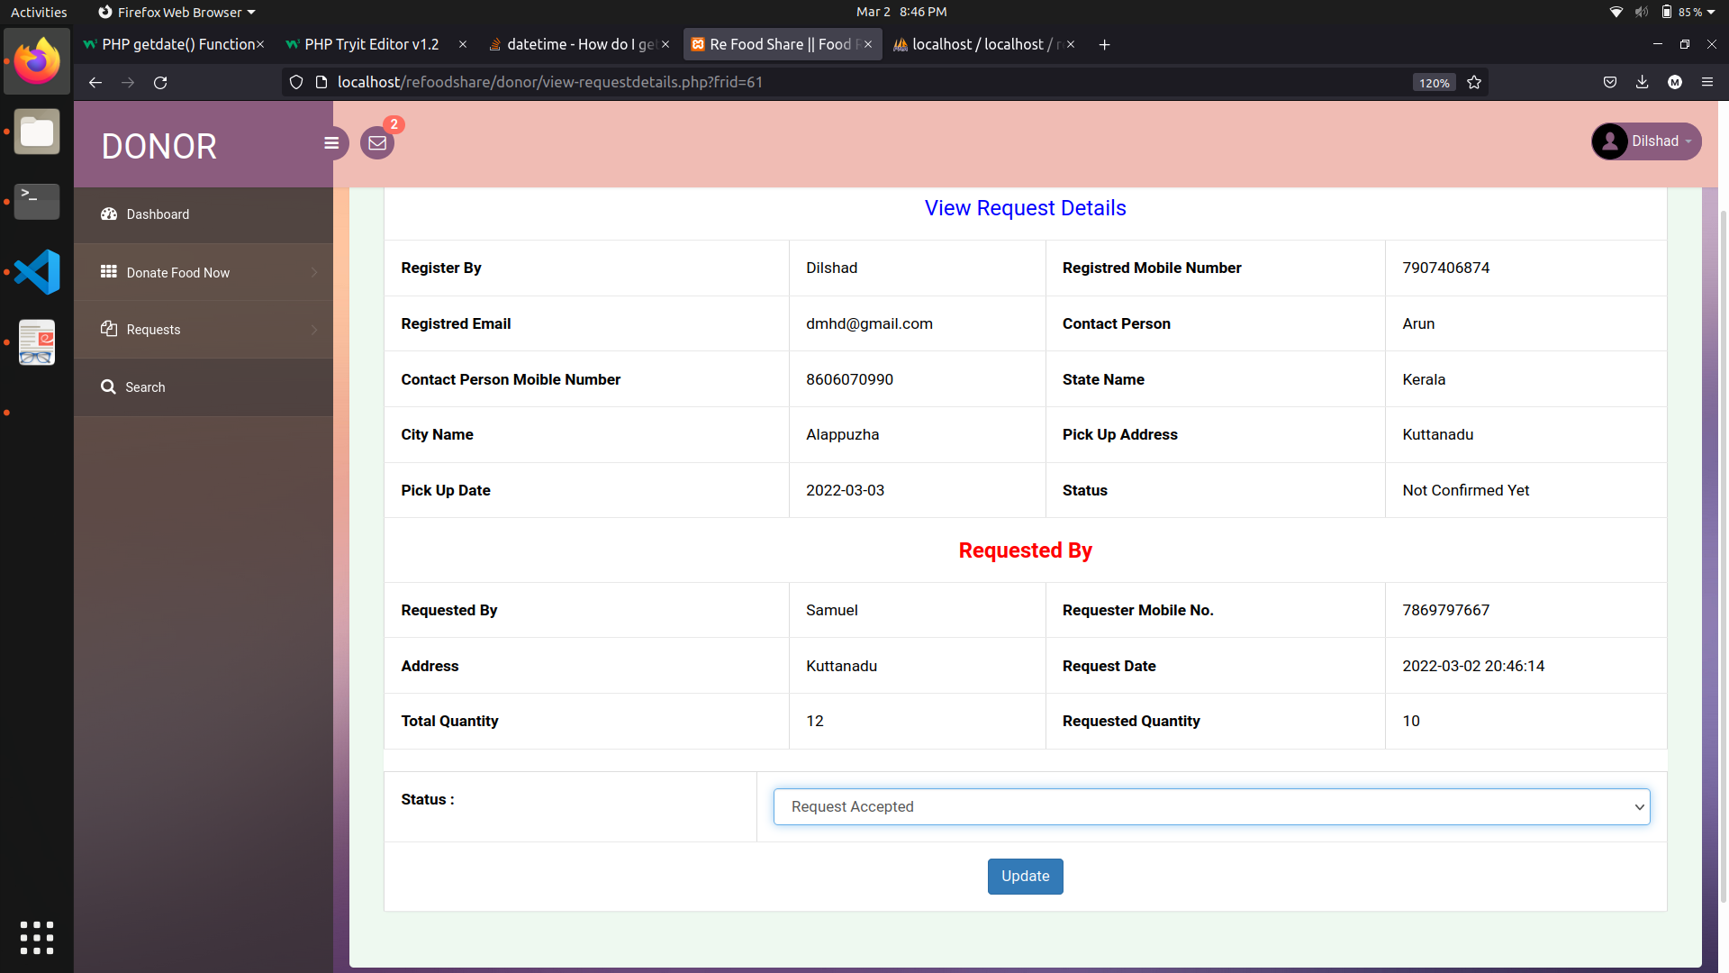

Slide 21
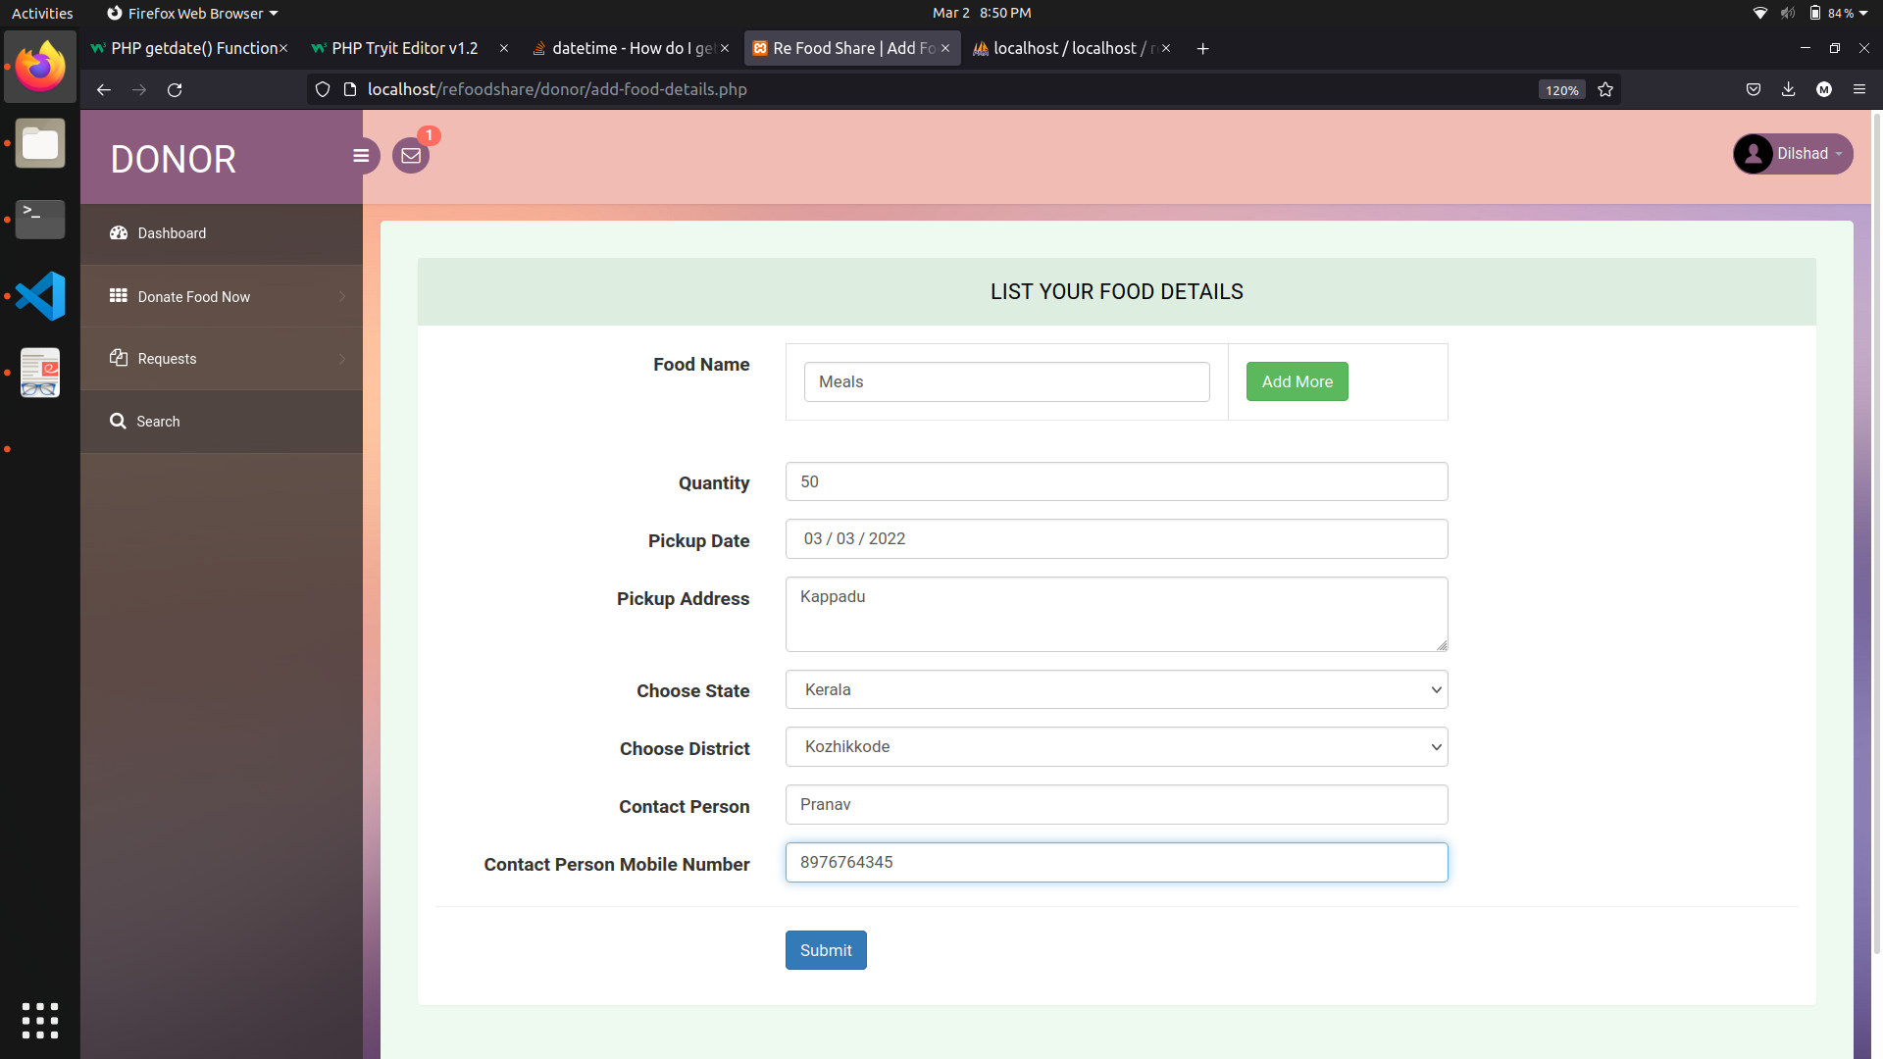

Slide 22
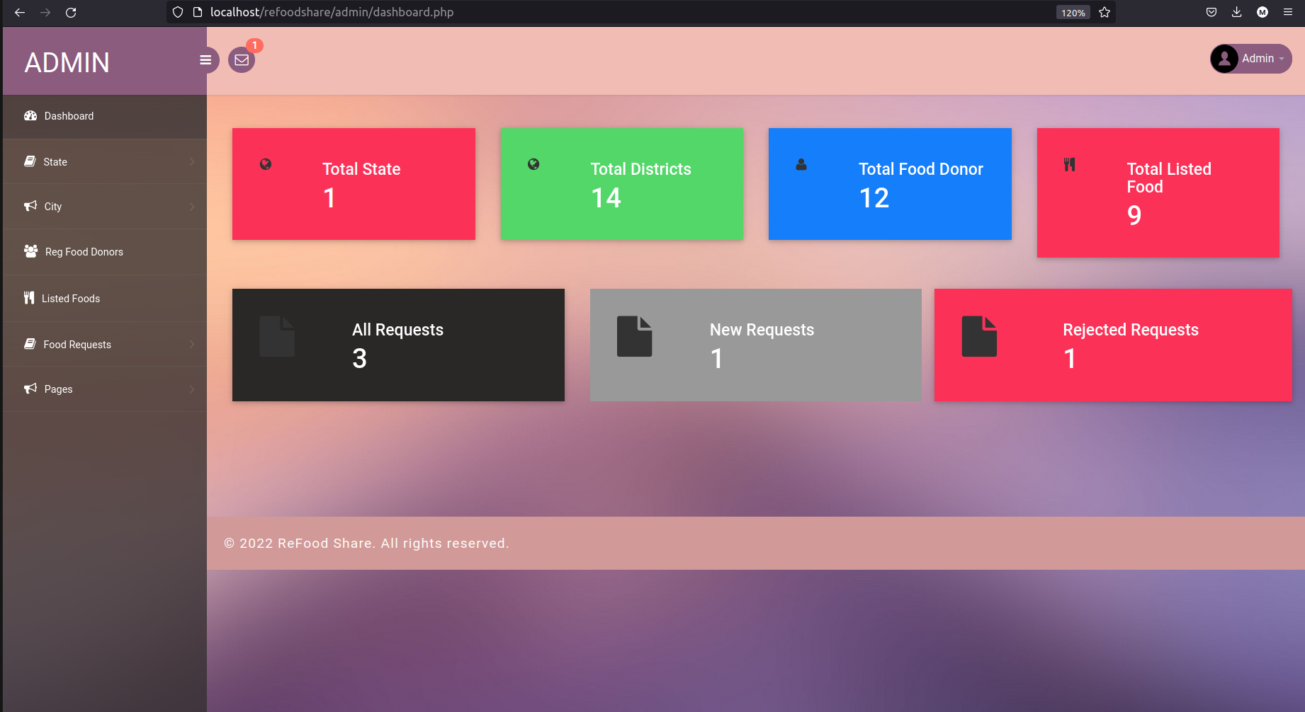

Slide 23
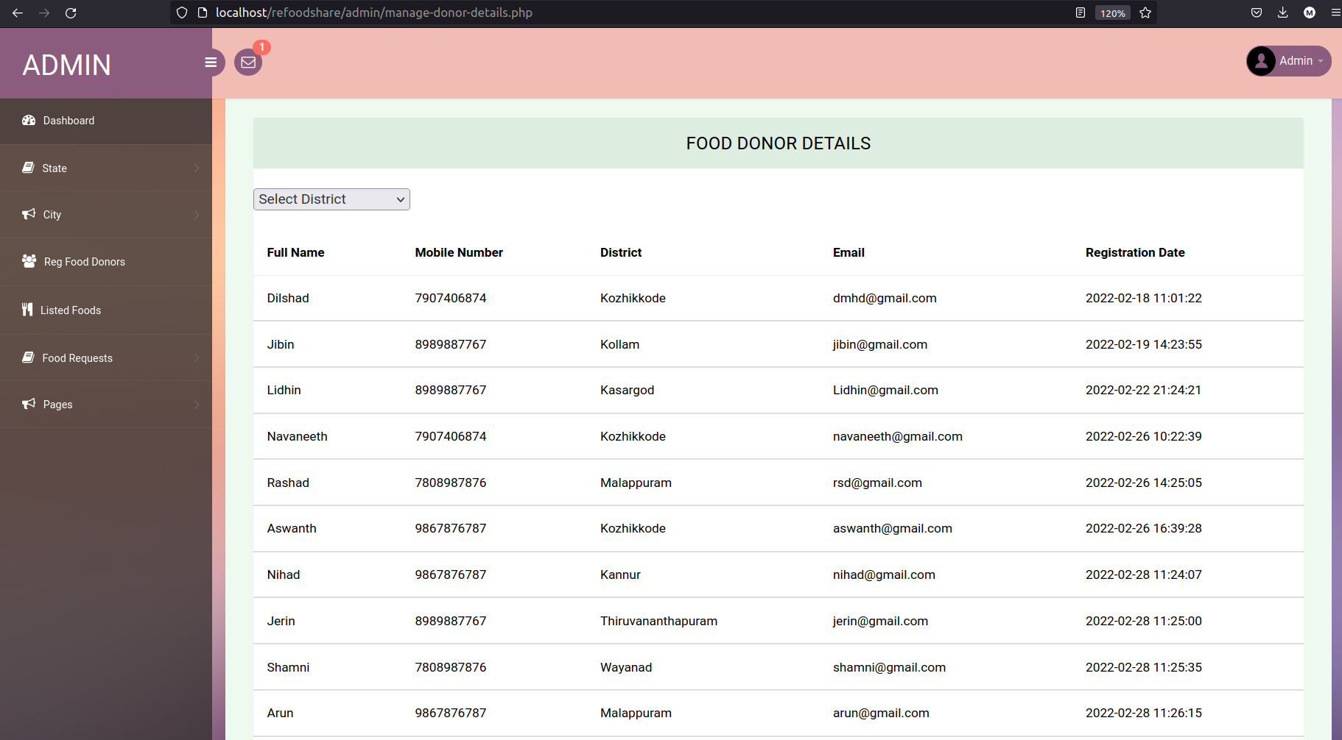

Slide 24
Data Flow Diagram

Slide 25
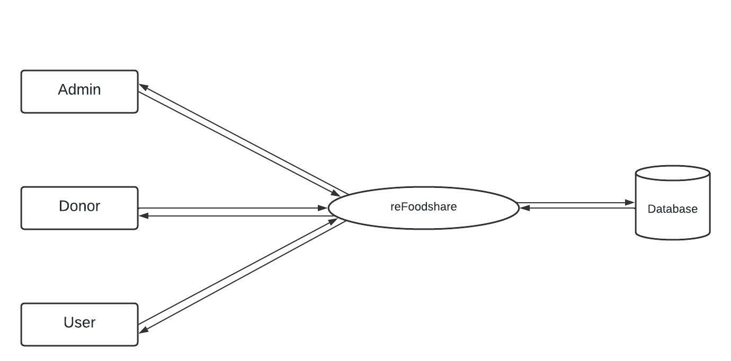
Level 0

Slide 26
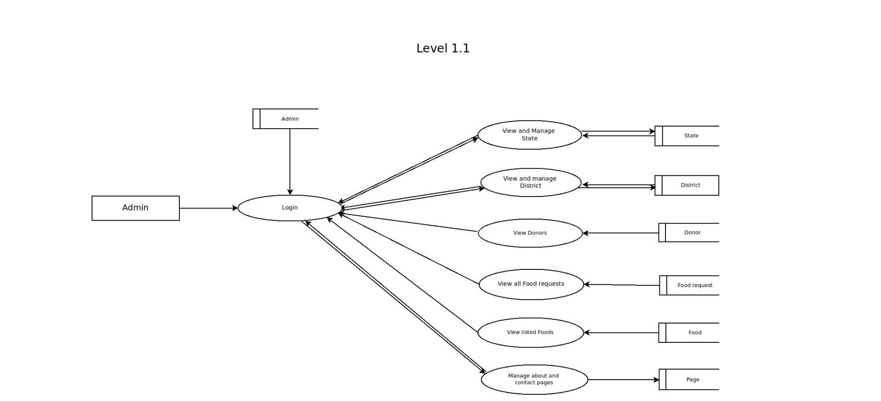
Level 1.1

Slide 27
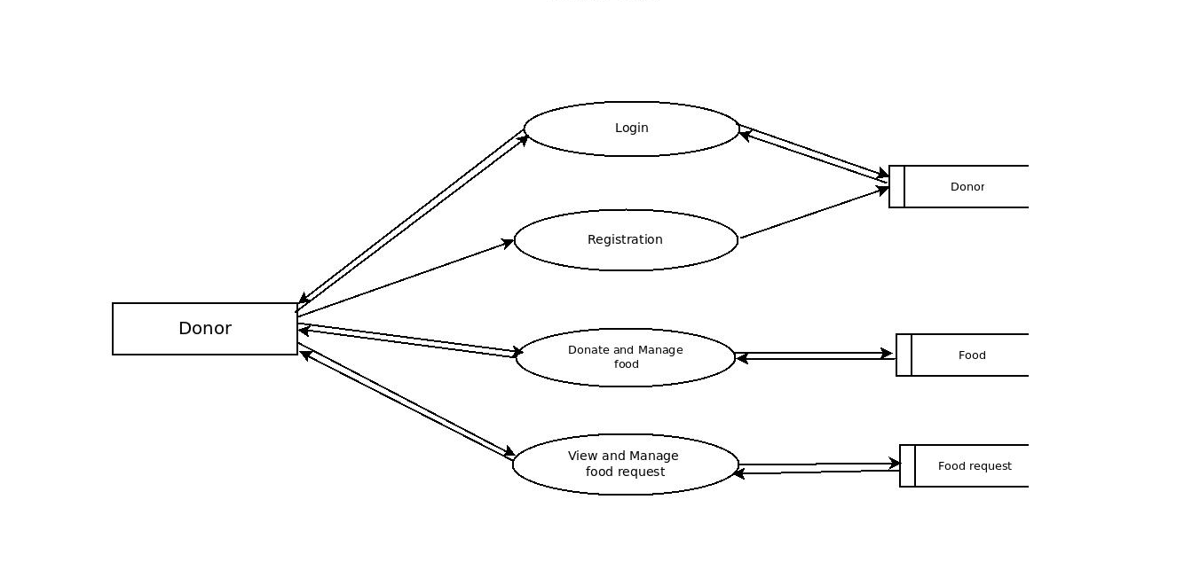
Level 1.2

Slide 28
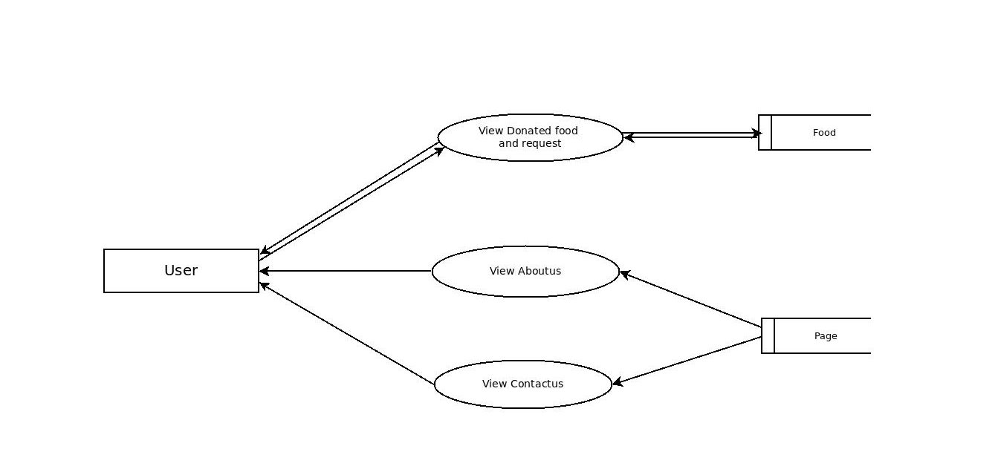
Level 1.3

Slide 29
Database Tables

Slide 30
1.Admin
Field | Datatype | Constraint
ID | int | Primary Key
AdminName | Varchar
UserName | Varchar
MobileNumber | int
Email | Varchar
Password | Varchar

Slide 31
2.Donor
Field | Datatype | Constraint
ID | int | Primary Key
FullName | Varchar
Email | Varchar
MobileNumber | int
Password | Varchar

Slide 32
3.Food
Field | Datatype | Constraint
Food ID | int | Primary Key
Donor Id | int | Foreign Key
FoodName | Varchar
State | Varchar
District | Varchar
Quantity | int
PickupDate | Date
PickupAddress | MediumText
ContactPerson | Varchar
CPMobNumber | int

Slide 33
4.Food request
Field | Datatype | Constraint
ID | int | Primary Key
RequestNumber | int
Food id | int | Foreign Key
FullName | Varchar
MobileNumber | int
RequestQuatity | int
Address | MediumText
Status | Varchar

Slide 34
5.State
Field | Datatype | Constraint
ID | int | Primary Key
State | Varchar

Slide 35
6.District
Field | Datatype | Constraint
ID | int | Primary Key
State id | int | Foreign Key
District | Varchar

Slide 36
7.Page
Field | Datatype | Constraint
ID | int | Primary Key
PageType | Varchar
PageTitle | MediumText
PageDesc | MediumText

Slide 37
THANK YOU

